Slide 1
MA1506 Mathematics II
Chapter 4
Laplace Transforms

Slide 2
4.0 Introduction
4.0 Introduction
In Chapter one, we have learnt how to solve
nonhomogeneous 2nd order linear ODE (with
or without initial conditions) by
Method of undetermined coefficients
Variation of parameters
In this Chapter, we shall study how to use
Laplace transforms to solve
nonhomogeneous 2nd order linear ODE
with initial conditions

Slide 3
4.0 Introduction
There are five parts in Chapter four.
Part 1: Laplace transforms and inverse
Laplace transforms
Part 2: Finding Laplace transforms and
inverse Laplace transforms using
known results
Part 3: Solving ODEs by Laplace transforms
Part 4: Laplace transforms of piecewise
continuous functions and ODEs
Part 5: Laplace transforms of impulse functions
and ODEs

Slide 4
4.1 Laplace transforms
Part 1 Laplace transforms and inverse Laplace transforms
Laplace transform L(f) is a mapping L
which maps a function f(t) to a function
F(s), where F(s) is given by

Slide 5
Example
4.1 Laplace transform
Let f(t)=1 for t>0. Then
where s>0 Why?
So Laplace transform maps
constant function 1 to function F(s)=1/s,
where s>0

Slide 6
4.1 Laplace transform
where s>0 Why?
ANS:
In the above, if s<0, then we will get
if s=0, then we will get

Slide 7
4.2 Inverse Laplace transform
If f(t)=1 for all t>0, then L(f)=1/s , s>0.
Hence the inverse Laplace transform of
1/s is f(t)=1. We write

Slide 8
4.3 Basic Laplace transforms
n=0,1,2…

Slide 9
4.3 Basic Laplace transforms
In the above, t>0, s>0
For the proofs, see appendix

Slide 10
4.4 Linearity
We can apply L T term by term
We can also apply inverse L T term by term
a, b are constants

Slide 11
4.5 Operational properties
Let
Then
where n is
positive integer
called s-shifting
where s>a

Slide 12
Part 2: Finding Laplace transforms and inverse Laplace transforms using known results
4.6 Finding Laplace transforms
Example 1
Example 2

Slide 13
Example 3
4.6 Finding Laplace transforms
Similarly,

Slide 14
Example 4
Find
4.6 Finding Laplace transforms

Slide 15
Example 5 s-shifting
4.6 Finding Laplace transforms
Recall
Hence

Slide 16
Example 5 s-shifting
4.6 Finding Laplace transforms
Recall
Hence

Slide 17
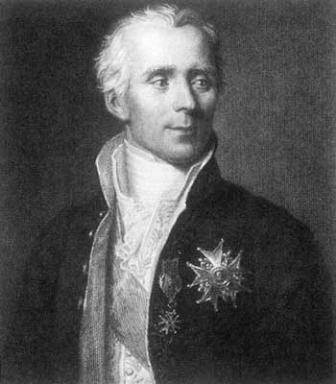
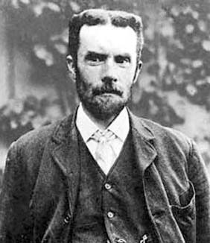
4.6 Finding Laplace transforms
The Laplace transform is named for the French mathematician Laplace, who studied this transform in 1782.
Pierre-Simon de Laplace (1749-1827)
The techniques described in this chapter were developed primarily by Oliver Heaviside (1850-1925), an English electrical engineer.
Oliver Heaviside (1850-1925)

Slide 18
4.6 Finding Laplace transforms
Engineer Oliver Heaviside used Laplace transforms
in the nineteenth century to solve ODE.
However the mathematical community would not
accept his work because he failed to justify his
Methods.
His reply: “ Should I refuse my dinner because I
do not understand the process of digestion”.
Heaviside’s method (using Laplace transforms to
solve ODE) finally has been justified in the
twentieth century.

Slide 19
4.7 Finding inverse Laplace transforms
Recall

Slide 20
4.7 Finding inverse Laplace transforms
Recall

Slide 21
Example 1
4.7 Finding inverse Laplace transforms
From
get

Slide 22
Example 2
4.7 Finding inverse Laplace transforms
From
get

Slide 23
Example 3
4.7 Finding inverse Laplace transforms
Let
Then

Slide 24
4.7 Finding inverse Laplace transforms
Example 4
Find
First

Slide 25
Recall
4.7 Finding inverse Laplace transforms

Slide 26
4.7 Finding inverse Laplace transforms
Example 5
Using partial fraction
we obtain A = 2, B = 5/3, C = 0, and D = -2/3.
Hence
Recall

Slide 27
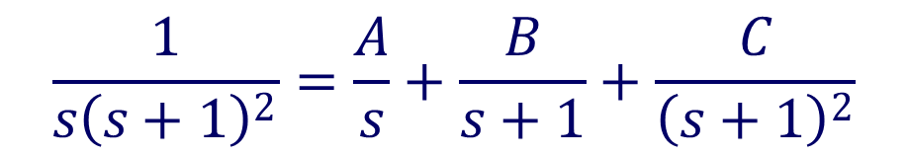
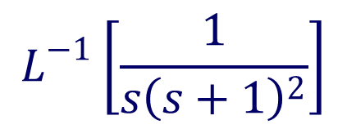
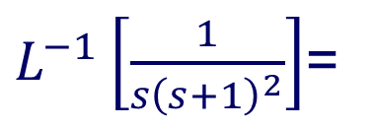
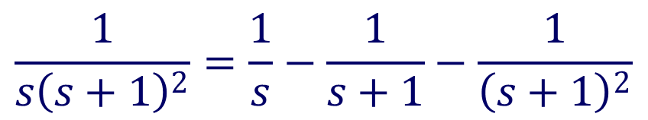

$$L^{−1}\left[\frac{1}{s{\left(s+1\right)}^{2}}\right]$$
Example 6
Find
$$\frac{1}{s{\left(s+1\right)}^{2}}=\frac{A}{s}+\frac{B}{s+1}+\frac{C}{{\left(s+1\right)}^{2}}$$
$$A=1, B=C=−1$$
$$\frac{1}{s{\left(s+1\right)}^{2}}=\frac{1}{s}−\frac{1}{s+1}−\frac{1}{{\left(s+1\right)}^{2}}$$
$L^{−1}\left[\frac{1}{s{\left(s+1\right)}^{2}}\right]$=

Slide 28
4.7 Finding inverse Laplace transforms
Example 7
Find y
In order to use
write
So

Slide 29
Example 8
4.7 Finding inverse Laplace transforms
Find the inverse transform of
Note: We can’t factorize the denominator
Need to use
We first complete the square

Slide 30
Finding Laplace transform and inverse Laplace transform on line
http://wims.unice.fr/wims/wims.cgi
http://www.wolframalpha.com/widgets/view.jsp?id=3272010f63d3145699ca78bbe0db05a7
Solving ODE by Laplace transform animation
http://www.atp.ruhr-uni-bochum.de/DynLAB/dynlabmodules/Examples/Laplacetransform/Rickeracke.html

Slide 31
4.8 Transform of derivatives
Part 3 Solving ODE by Laplace transforms
Note that after transform, derivatives disappear. So Laplace transform can be used to solve ODE and PDE. However, initial conditions should be given
For the proofs of the above results,
see appendix

Slide 32
Example 1
4.9 Solving ODE
Take Laplace Transform

Slide 33
4.9 Solving ODE
We shall use
Write
Take inverse transform, get
Remark:
using Method of undetermined
Coefficients is easier

Slide 34
Example 2
4.9 Solving ODE
ANS:
Example 3
ANS:
We remark that these two examples are given
in Lecture Note, They are solved by using Laplace
Transforms. In fact it is easier if using method of
undetermined coefficients.

Slide 35
4.9 Solving ODE
When we use Laplace transforms to solve
Nonhomogeneous 2nd order linear ODE?
If those ODE which can be solved by
method of undetermined coefficients or variation of parameters, then we will not use Laplace transforms to solve them
We need to use Laplace Transforms to solve
those examples in next two sections, since
we have difficulty to use the above
two methods there

Slide 36
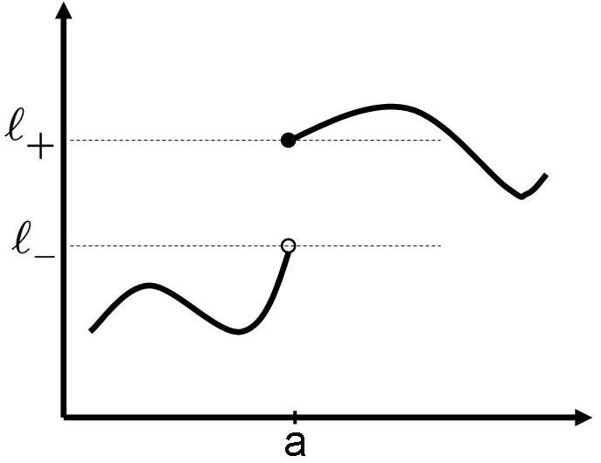
4.10 Piecewise Continuous Functions
Part 4 Laplace transforms of piecewise continuous
functions and ODEs
Jump discontinuity at a
finite value
finite value

Slide 37
piecewise continuous
4.10 Piecewise Continuous Functions
Not piecewise cont
since
a

Slide 38
4.11 Unit Step (Heaviside) Function
1
●
From now onwards,
we will not draw
○
a
●
○

Slide 39
Example 1
4.11 Unit Step (Heaviside) Function
u(t-1)
1
3
u(t-3)
1
3
1
3

Slide 40
Example 2
4.11 Unit Step (Heaviside) Function
1
a
b

Slide 41
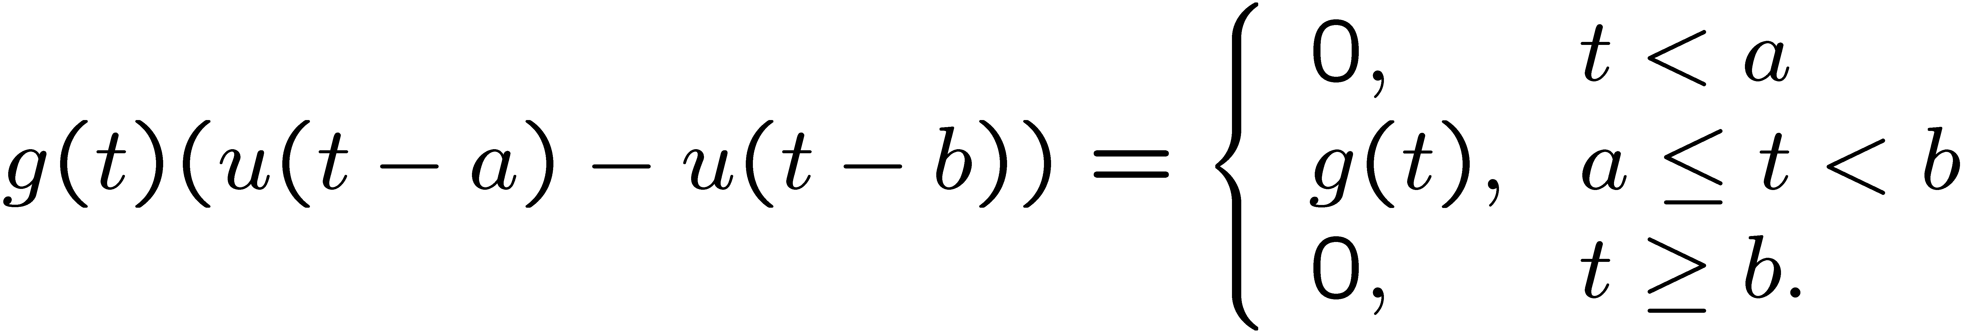
Example 3
4.11 Unit Step (Heaviside) Function
Let g(t) be a function of t. Then
u(t-a)-u(t-b)
g(t)
a
b
a
b

Slide 42
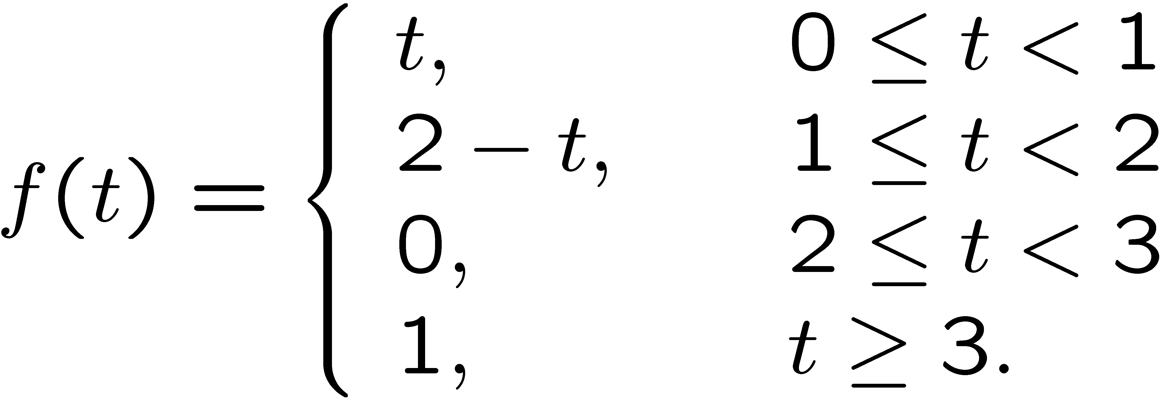
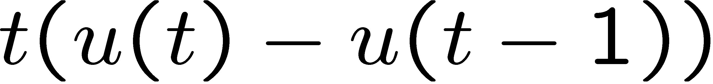
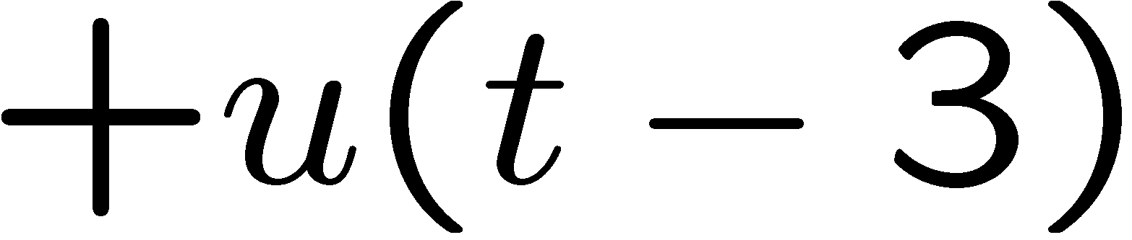
Example 4
4.11 Unit Step (Heaviside) Function
Piecewise cont. function in terms of u(t)
1 2 3 4

Slide 43
4.12 t-Shifting
Suppose
Then
a
a

Slide 44
4.12 t-Shifting
Suppose
Then
Hence
Recall
is also denoted by

Slide 45
Example 1
4.12 t-Shifting
Use
to find

Slide 46
Example 1
4.12 t-Shifting
Recall

Slide 47
Example 2
4.12 t-Shifting
Use
to find

Slide 48
Example 2
4.12 t-Shifting
Recall

Slide 49
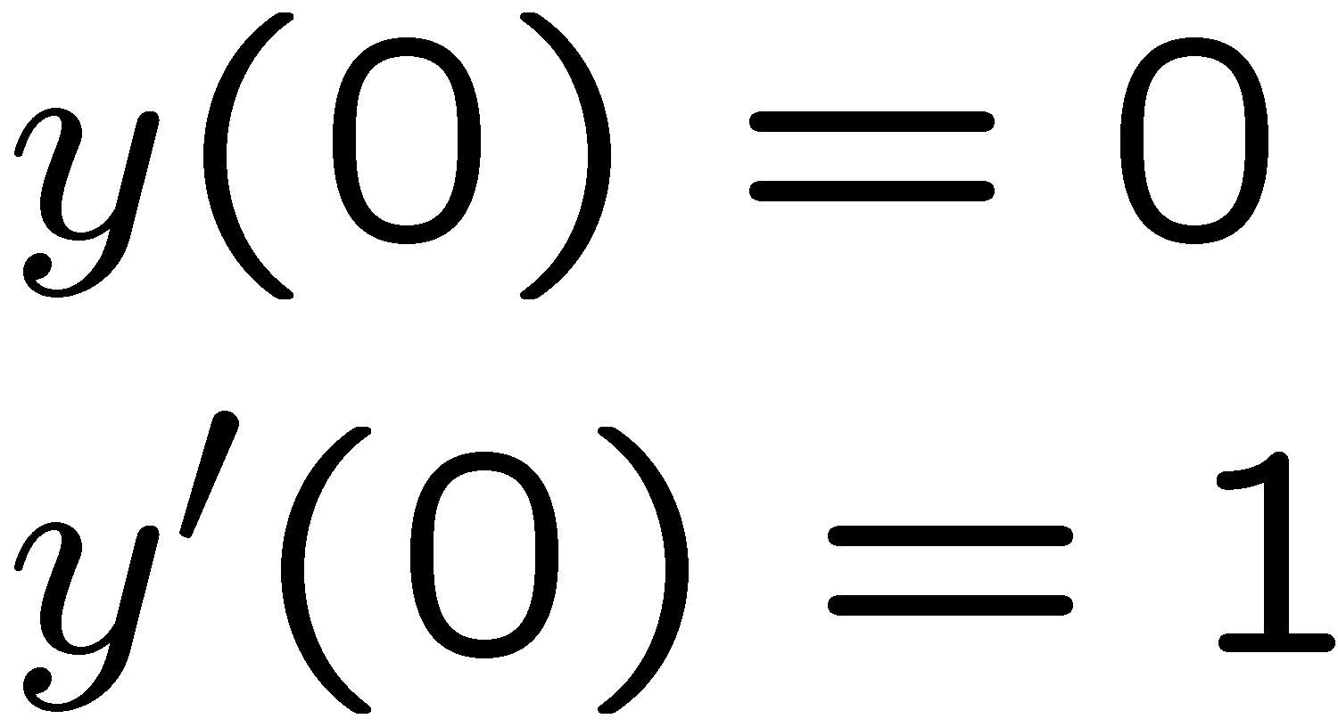
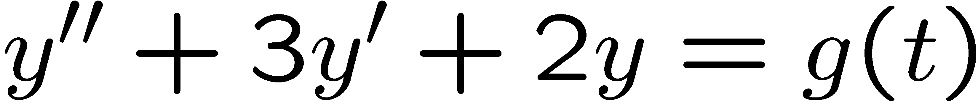
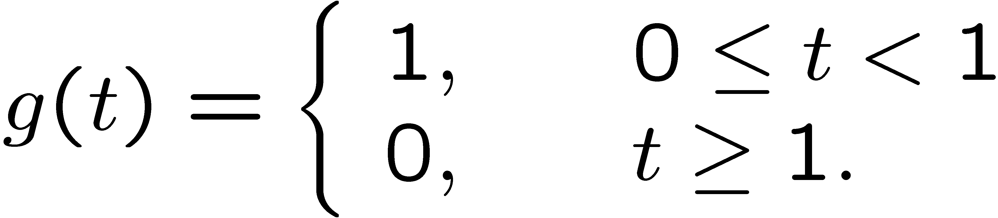
Example
4.13 t-Shifting and ODE
4.13 t-Shifting and ODE
where

Slide 50
4.13 t-Shifting and ODE
Now compute
Recall
So

Slide 51
4.13 t-Shifting and ODE
Now find
and

Slide 52
4.13 t-Shifting and ODE

Slide 53
To find
4.13 t-Shifting and ODE
Recall
So
Now need to find
i.e. to find

Slide 54
4.13 t-Shifting and ODE
Recall
So

Slide 55
4.13 t-Shifting and ODE
from
get
Hence

Slide 56
Part 5: Laplace transforms of impulse functions and ODEs
In some applications, it is necessary to deal with an impulsive force.
For example, a mechanical system subject to a sudden large force g(t) over a short time interval about t₀.
The differential equation will then have the form

Slide 57
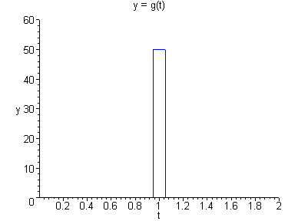
(Cont.)

Slide 58
4.14 Measuring Impulse
In a mechanical system, where g(t) is a
force, the total impulse of this force is
measured by the integral

Slide 59
4.14 Measuring Impulse
Note that if g(t) has the form
then
In particular, if c = 1/(2τ), then (independent of τ ).

Slide 60
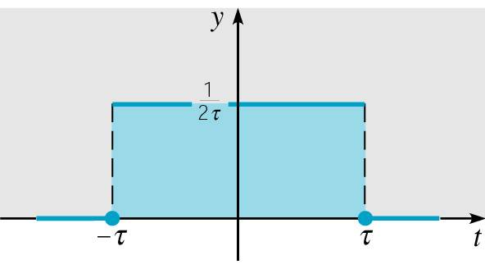
Unit Impulse Function
4.14 Measuring Impulse
Suppose the forcing function d_{τ}(t) has the
form
Then as we have seen,

Slide 61
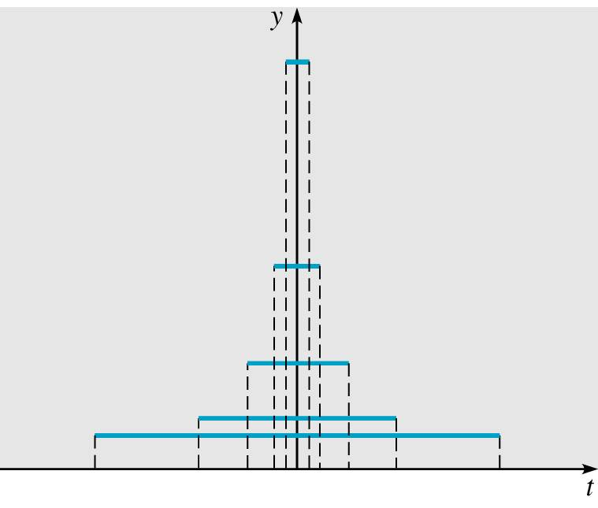
4.14 Measuring Impulse
We are interested in d_{τ}(t) acting
over shorter and shorter time
intervals (i.e., τ → 0). See
graph on right.
Note that d_{τ}(t) gets taller and narrower as τ → 0. Thus for t ≠ 0, we have
t≠0 why?

Slide 62
Dirac Delta Function
4.14 Measuring Impulse
Thus for t ≠ 0, we have
The unit impulse function δ is defined to have the properties

Slide 63
4.14 Measuring Impulse
The unit impulse function is an example of a
generalized function and is usually called
the Dirac delta function.
In general, for a unit impulse at an arbitrary
point t₀,

Slide 64
4.15 Laplace Transform of δ
The Laplace Transform of δ is defined by
We can proved that
For example, we have

Slide 65
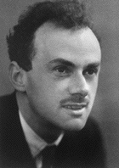
4.15 Laplace Transform of δ
Paul A. M. Dirac (1902-1984), an English
physicist, received the Nobel prize at age 31 for
his work in quantum theory
When Dirac introduced his delta functions
in early 1930s, again mathematical
community was somewhat suspect
Finally his delta functions have been
Justified. Today, delta functions
have a solid place.

Slide 66
Example 1
4.16 impulse functions and ODE
Solve
Apply L T, get

Slide 67
4.16 impulse functions and ODE
Substituting in the initial conditions, we obtain

Slide 68
4.16 impulse functions and ODE
Recall
Then

Slide 69
4.16 impulse functions and ODE
By
get

Slide 70
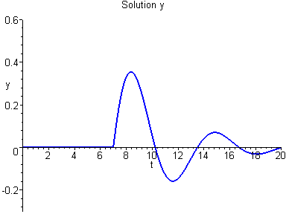
4.16 impulse functions and ODE
From above we have
So

Slide 71
Example 2
4.16 impulse functions and ODE
A mass m=1 is attached to a spring with
constant k=4 and released from rest 3
units below its equilibrium position. Hence
we have
x
equilibrium position

Slide 72
Example 2
4.16 impulse functions and ODE
Now at the instant t=2π the mass is struck
with a Hammer in the downward direction,
exerting an impulse of 8 units
on the mass.
So we have

Slide 73
Solution
4.16 impulse functions and ODE
Apply L T to the above ODE, get

Slide 74
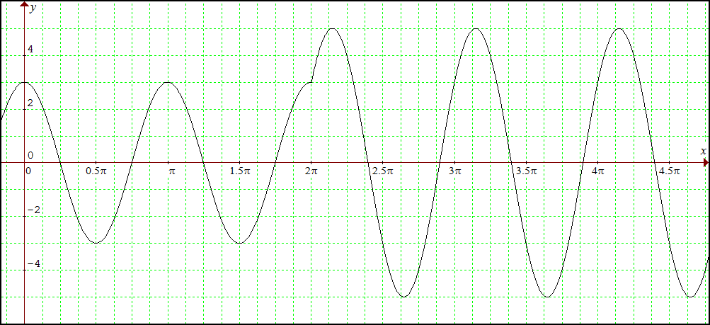
Solution
4.16 impulse functions and ODE

Slide 75
Example 3 : Injections
It is known that the body removes morphine
from the bloodstream at the rate proportional
to the amount of morphine present y(t)
where unit of t is day
Hence
So
Let t=0, get
So

Slide 76
Example 3 : Injections
Now shall find k
It is given that
half-life of morphine = 18 hours = 0.75 days
i.e.,
So the soln is
and the ODE is

Slide 77

Example 3 : Injections
Assume that no morphine was in the body
before t=0
Now at t=0, 100mg morphine was injected
almost instantly (impulsive injection)
into a patient,
can be written as
at t=1, another 100mg was injected
Hence we have

Slide 78
Example 3 : Injections
Here y(0)=0

Slide 79
Example 3 : Injections
2nd method

Slide 80
4.17 Parameter Reconstruction
Sometimes it happens that you have a system
whose nature you understand (e.g it is a damped
harmonic oscillator), but you don’t know the values
of the parameters (e.g the spring constant, the mass,
the friction coefficient)
In such case, what you can do is to poke the system
with a sudden, sharp force and watch how it behaves
For example, if it is a damped harmonic oscillator
, after poking,at t=1, we observe the displacement of
the mass, say

Slide 81
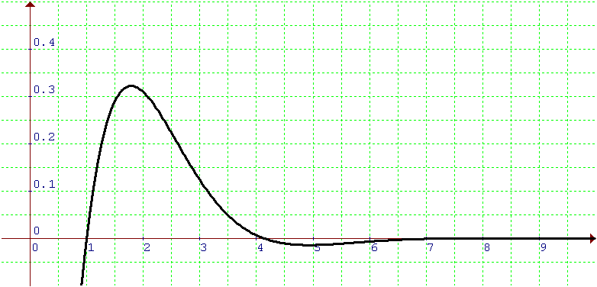
4.17 Parameter Reconstruction
How to get the above equation?
ANS: We can use Graphmatica to guess
the equation of the curve
Now with the above equation (soln) , we can
find the mass, the spring constant, the friction
coefficient as follows

Slide 82
4.17 Parameter Reconstruction
It is known that
Apply L T, get

Slide 83
4.17 Parameter Reconstruction
On the other hand, the L T of
is
Compare with
We have

Slide 84
4.17 Parameter Reconstruction
Hence

Slide 85
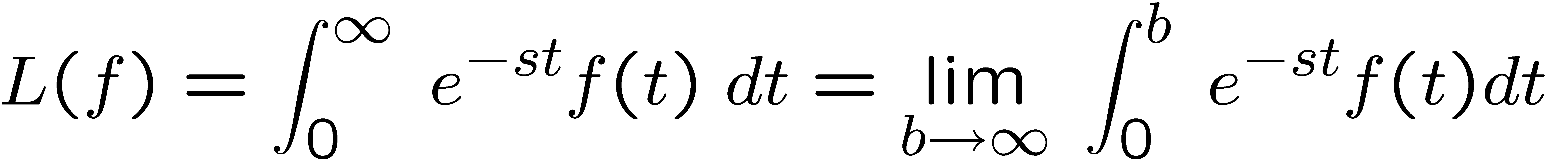
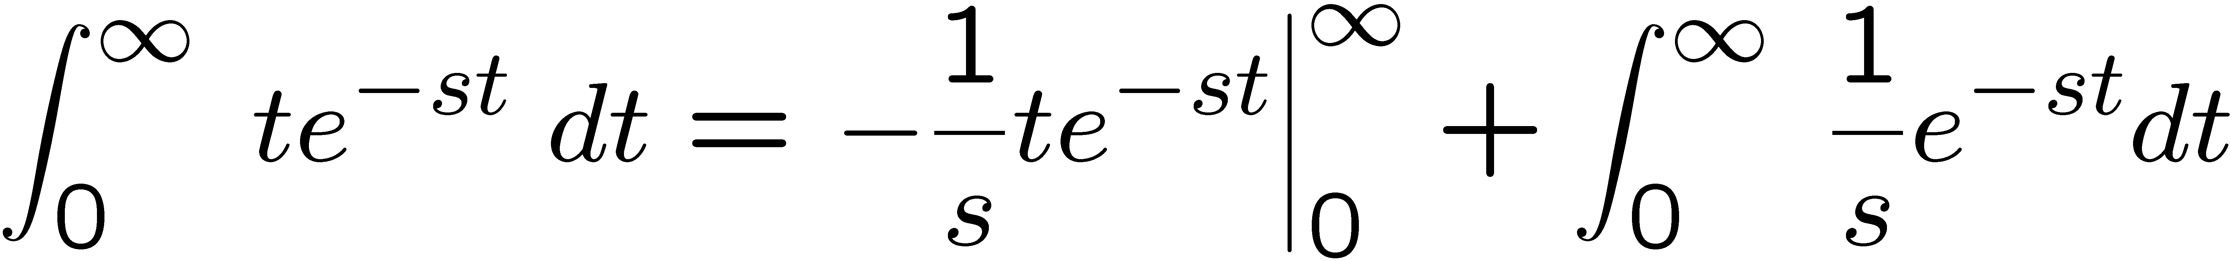
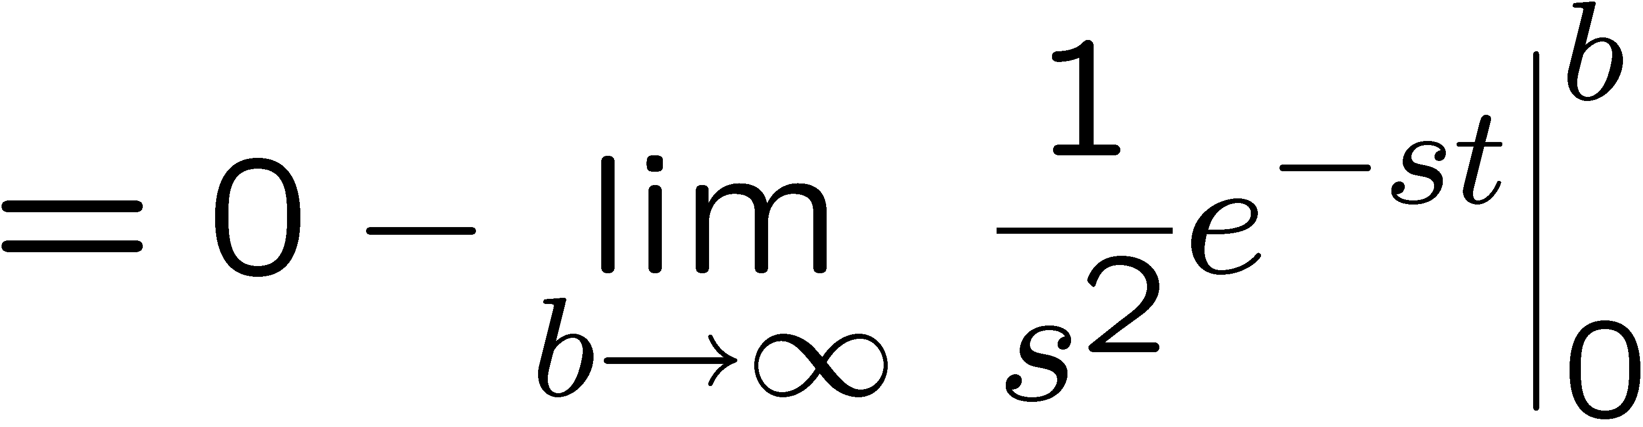
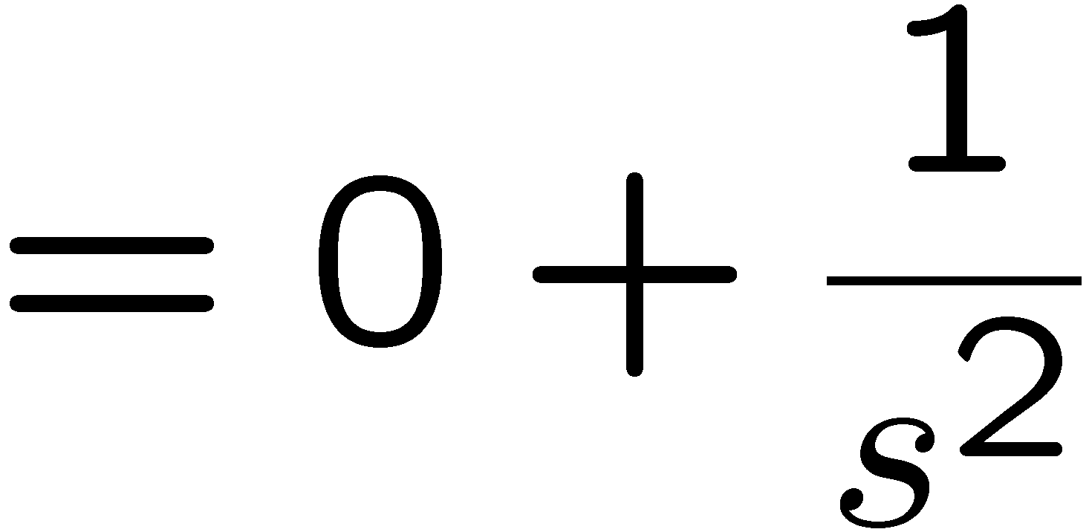
Laplace transforms
APPENDIX

Slide 86
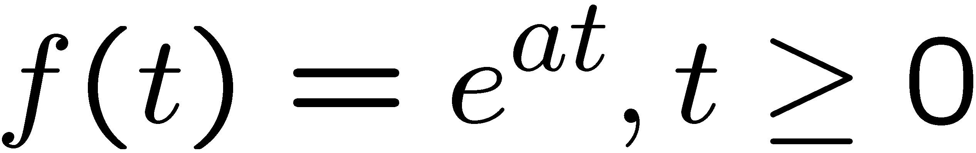
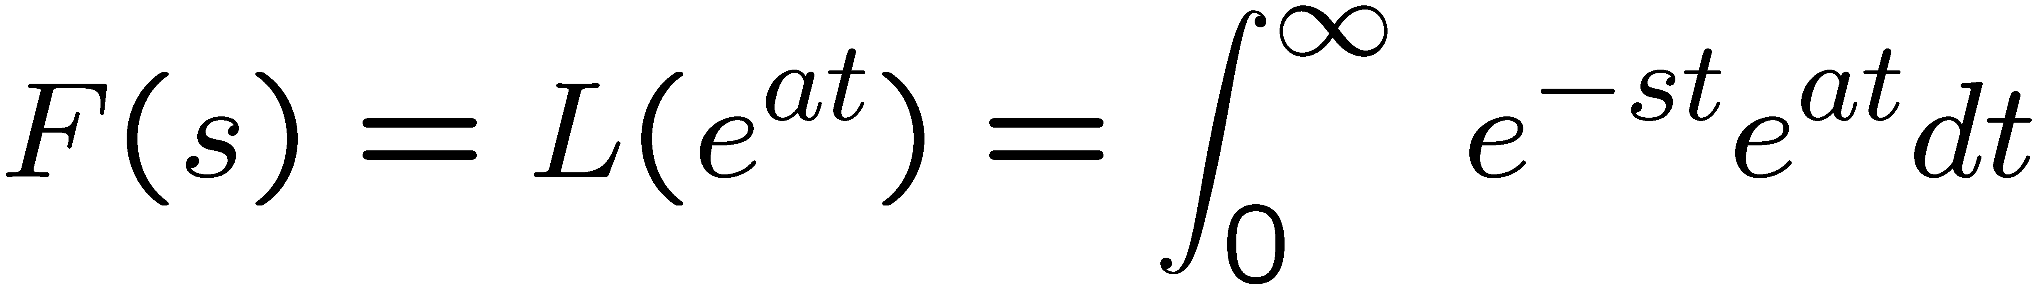
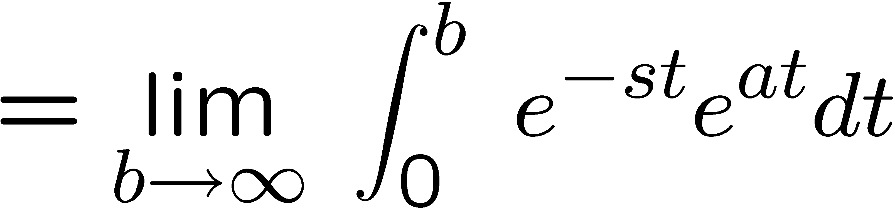
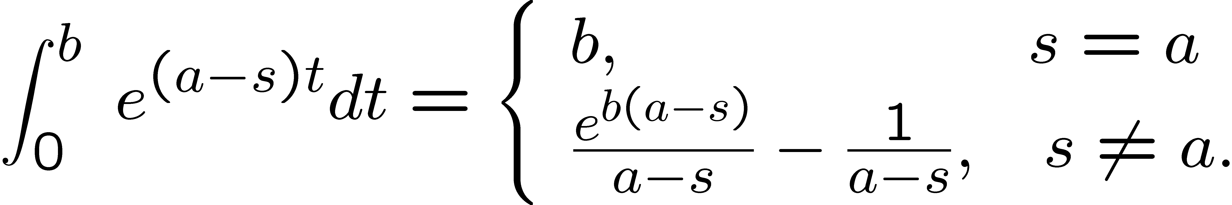
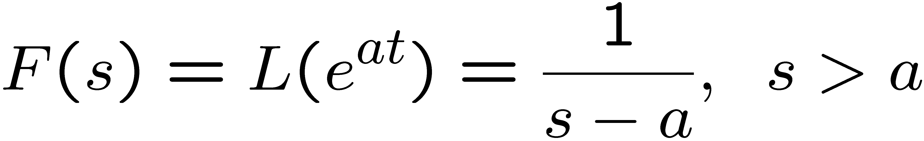
Example
APPENDIX

Slide 87
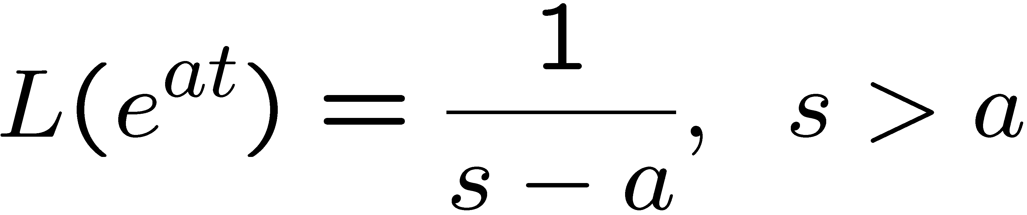
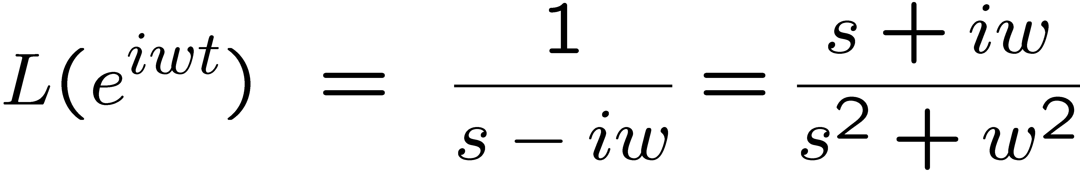
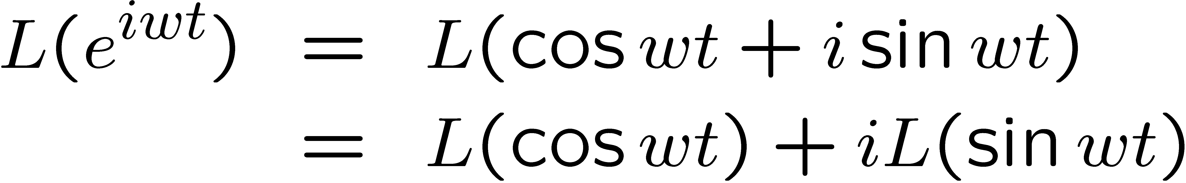
Example
APPENDIX
Set a = iw

Slide 88
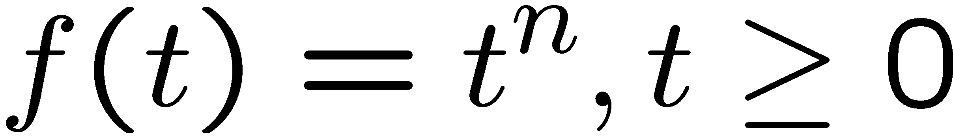
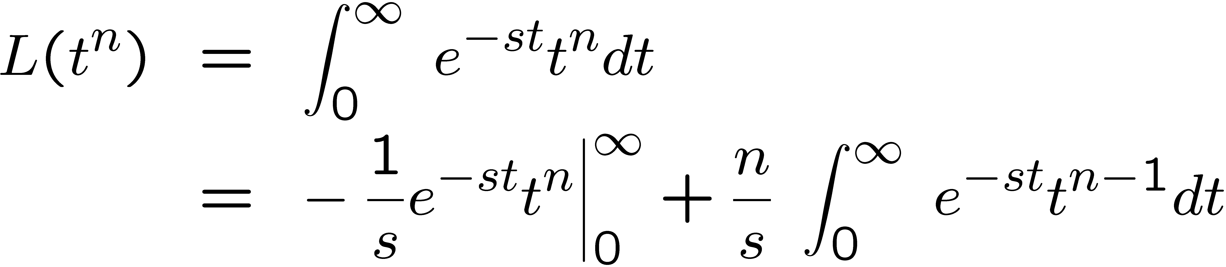
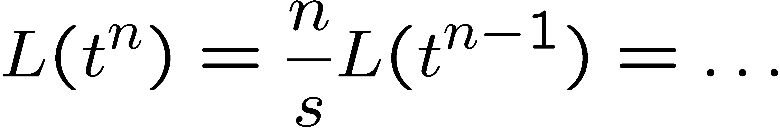
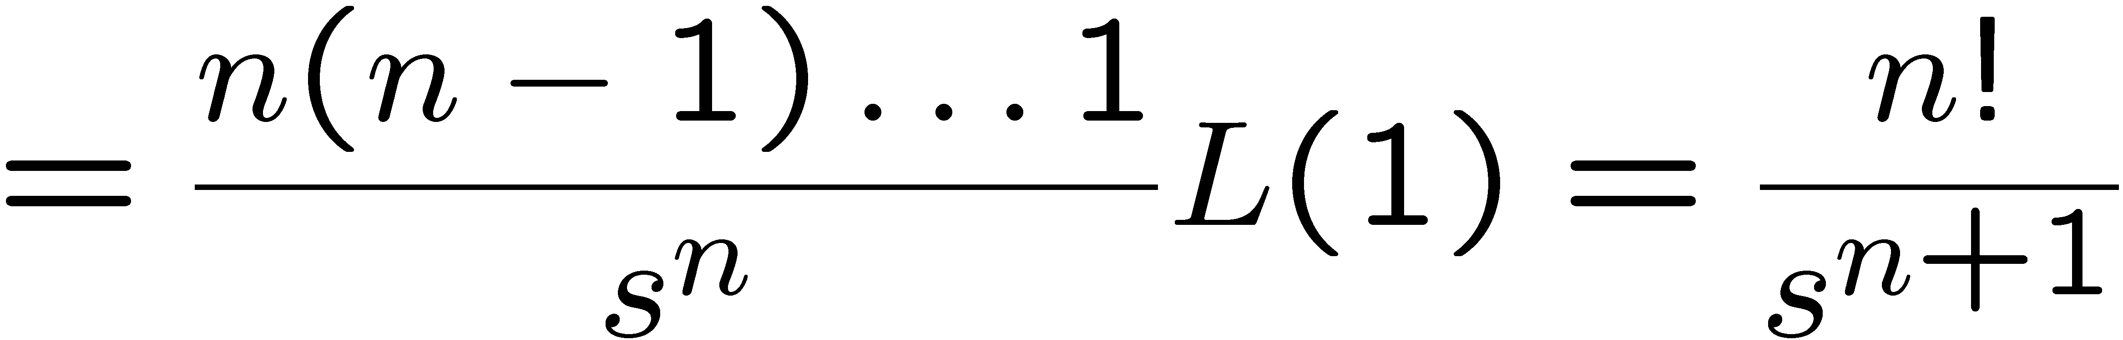
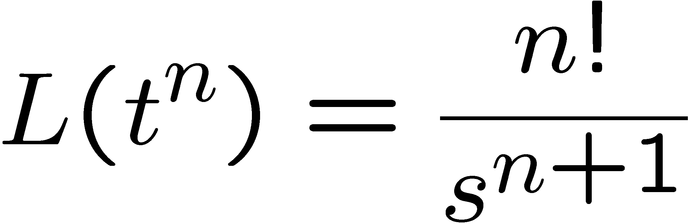
Example
APPENDIX

Slide 89
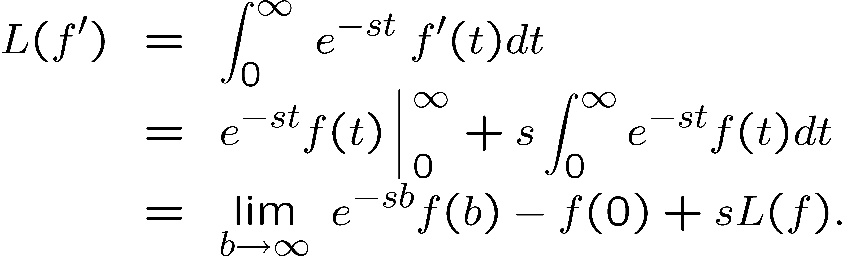
Transform of Derivatives and Integrals
APPENDIX
Pf

Slide 90
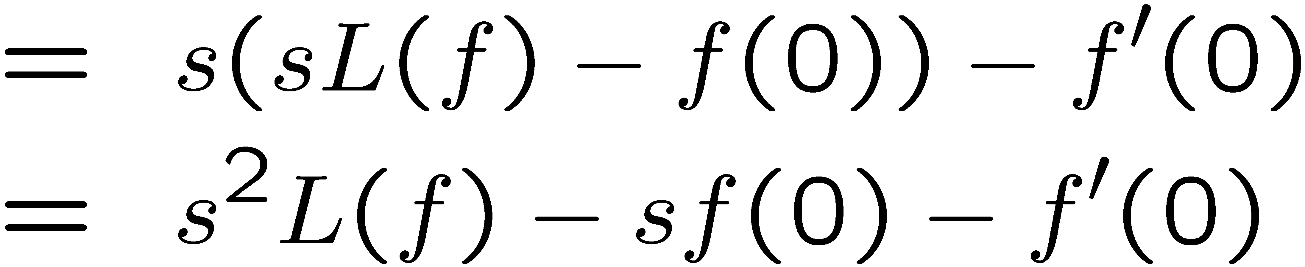
Transform of Derivatives and Integrals
APPENDIX

Slide 91
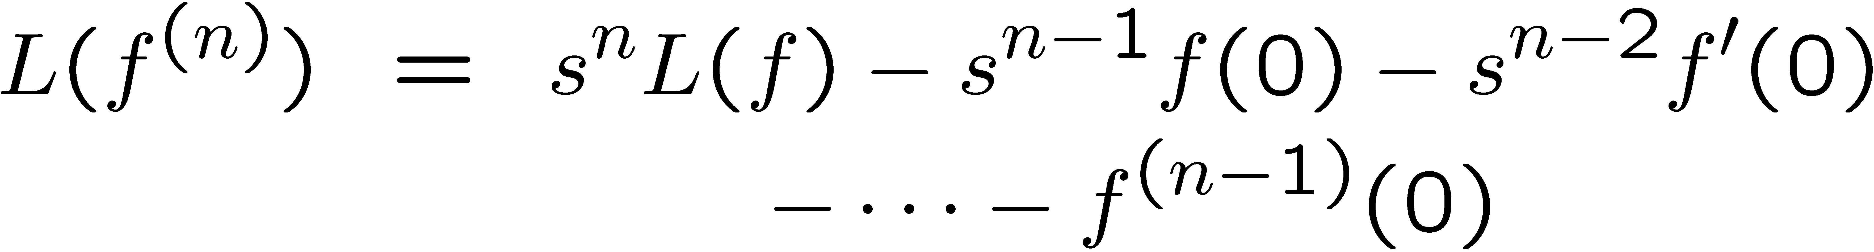
Transform of Derivatives and Integrals
APPENDIX

Slide 92
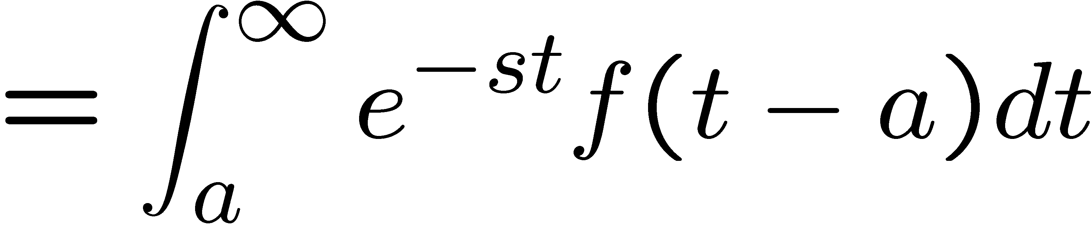
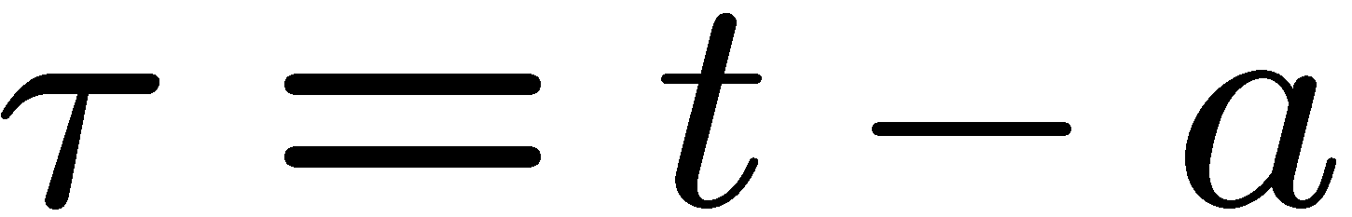
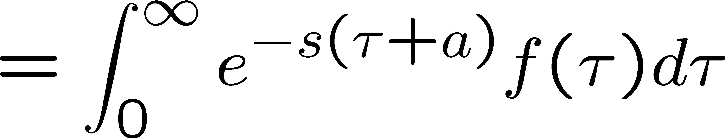
t-Shifting
APPENDIX
If L(f(t)) = F(s) then

Slide 93
Additional Operational properties
APPENDIX
Apply L’ Hopital’s rule to
form

Slide 94
Laplace Transform of δ
APPENDIX
The Laplace Transform of δ is defined by

Slide 95
Cont.
APPENDIX
o/o form

Slide 96
Product of Continuous Functions and δ
APPENDIX
The product of the delta function and a continuous function
f can be integrated, using the mean value theorem for
integrals:

Slide 97
Cont.
APPENDIX
Thus
End
Chapter 4

